Slide 1
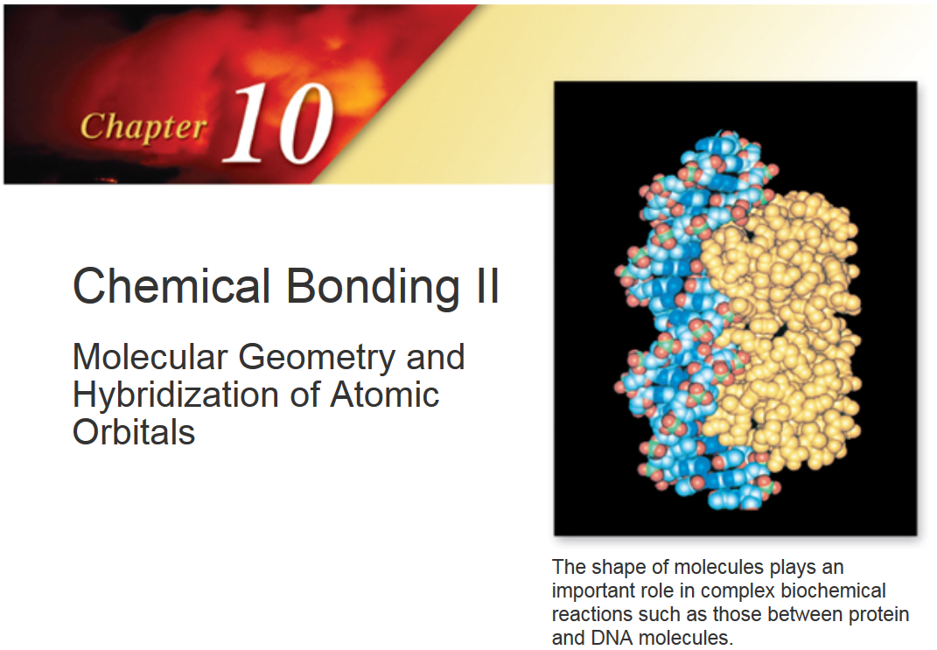

Slide 2
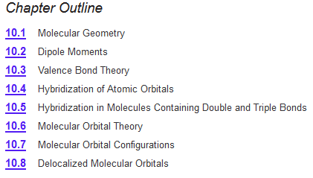

Chapter 10

Slide 3
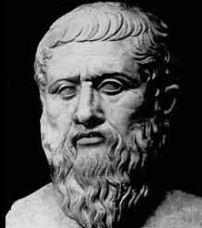
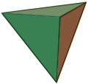
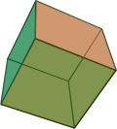
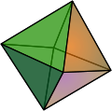


“Elemental” Geometries
Plato
Each of the five classical elements (ether, earth, air, fire, and water) has a shape.
circa 428 ─ 348 B.C.
Greek Philosopher
Tetrahedron
Hexahedron
Octahedron
Dodecahedron
Icosahedron

Slide 4
“Elemental” Geometries
Tetrahedron
Hexahedron
Octahedron
Dodecahedron
Icosahedron
Euclidean Geometry:
A Platonic solid is a regular, convex polyhedron with congruent faces of regular polygons and the same number of faces meeting at each vertex. Five solids meet those criteria, and each is named after its number of faces.
https://en.wikipedia.org/wiki/Platonic_solid
Notes:
What is platonic solid
1. All the solid angles are equivalent.
3. All the vertices are surrounded by the same number of faces.

Slide 5
“Elemental” Geometries
Tetrahedron
Hexahedron
Octahedron
Dodecahedron
Icosahedron
Fire
Earth
Air
Water
The building blocks of the universe according to Plato:
Earth, Water, Fire, Air, Ether.
https://en.wikipedia.org/wiki/Platonic_solid
Notes:
What is platonic solid
1. All the solid angles are equivalent.
3. All the vertices are surrounded by the same number of faces.

Slide 6
“Elemental” Geometries
Tetrahedron
Hexahedron
Octahedron
Dodecahedron
Icosahedron
Fire
Earth
Air
Ether
Water
“The dodecahedron has 12 faces, and our number symbolism associates 12 with the zodiac, and this might be Plato's meaning when he wrote of "embroidering the constellations" on the dodecahedron”.
Notes:
Connection between platonic solid and elements

Slide 7
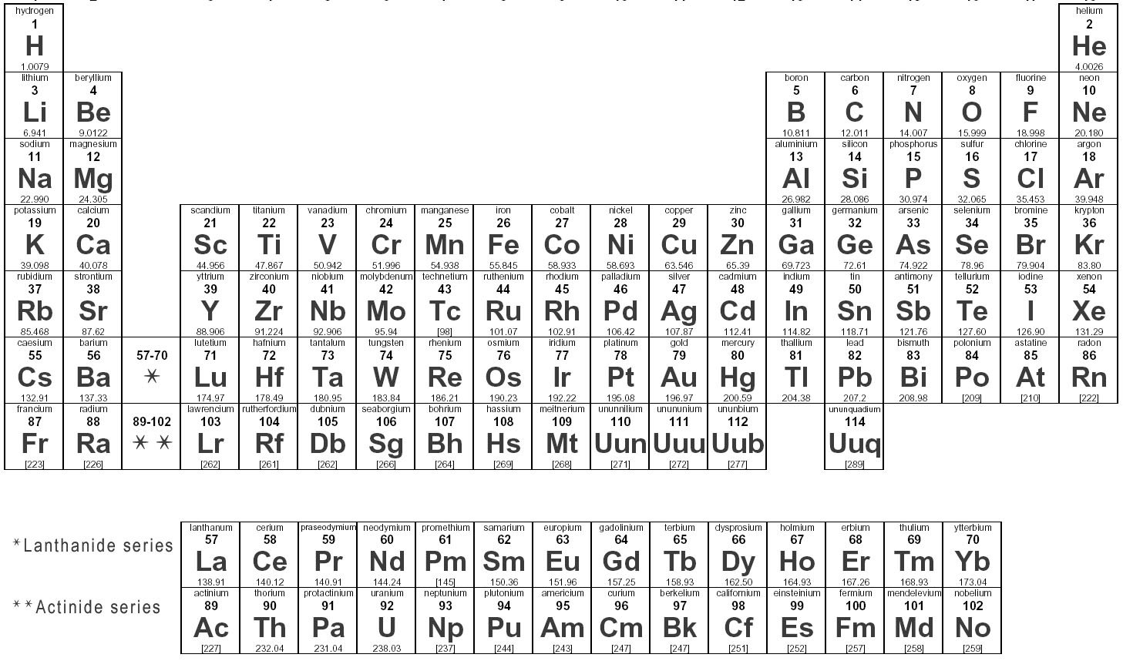
What Plato didn't know!
Atoms combine via chemical bond to make molecules
Molecules have shapes
Molecular shapes dictate their properties

Slide 8
Chemical Bonds
Attractive forces that hold atoms together in compounds are called chemical bonds.
There are two main types of chemical bonds
Ionic bonds – resulting from electrostatic attraction between cations and anions
Covalent bonds – resulting from sharing of one or more electron pairs between two atoms

Slide 9
The Octet Rule
In most compounds, the representative elements achieve noble gas configurations
Lewis dot formulas are based on the octet rule
Electrons which are shared among two atoms are called bonding electrons
Unshared electrons are called
lone pairs or nonbonding electrons
Ch 9.4
Page 379

Slide 10
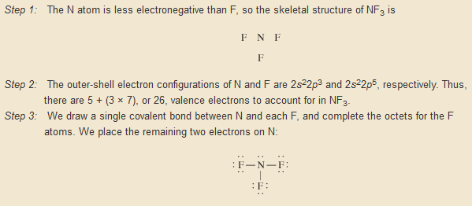
Lewis Dot Structures
Organize the atoms
Count total electrons
Draw a 2 e⁻ bond between the atoms
Add electrons/bonds until you use up the total e⁻ and you reach an octet.
Ch 9.6
Page 386

Slide 11
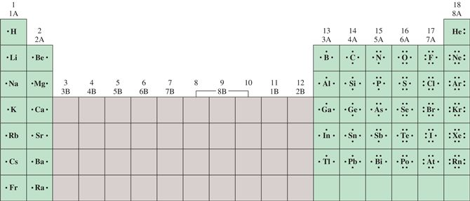
Alternative Strategy
From Page 371
NF₃
Combine unpaired electrons
Need 1 electron each
Needs 3 electrons

Slide 12
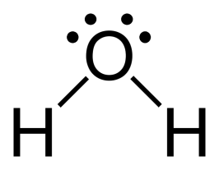

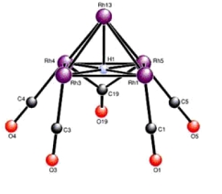
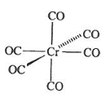
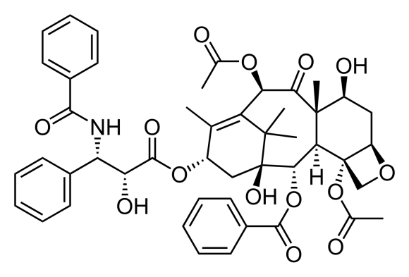
Shortcomings of Lewis Dot/Octet Rule
Does not tell you the geometry (shape) of the molecule.
vs.
Violations of the “octet” rule.
Can get complex quickly.
???
C₄₇H₅₁NO₁₄
328 e⁻

Slide 13
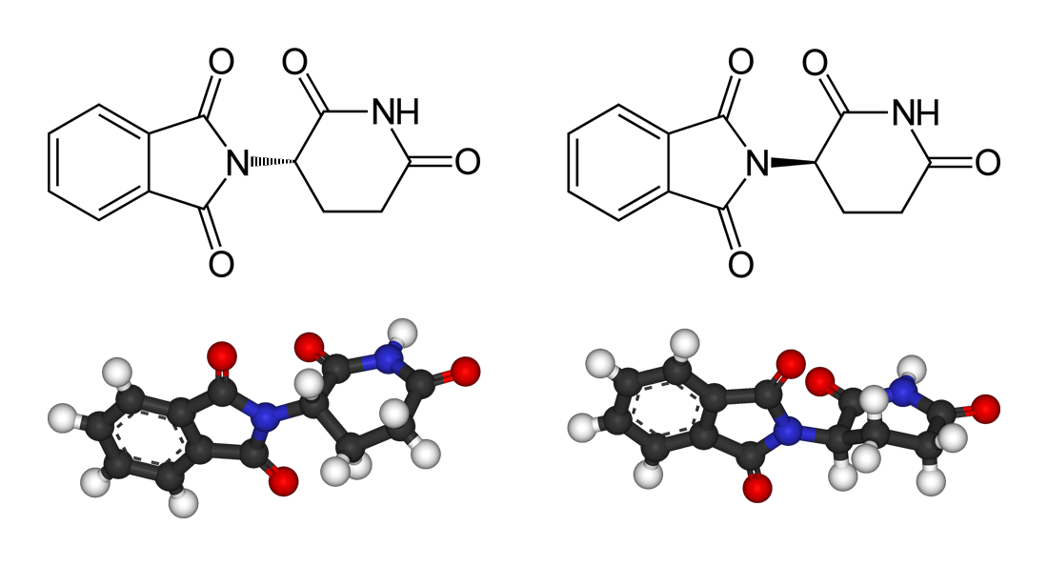
Shapes of Molecules
It is important to know how the atoms are arranged with respect to each other in 3-D space, i.e. molecular shape
Molecule’s shape affects its properties:
- melting and boiling points
- density of the compound
- chemical reactivity
- dipole moments
- chirality
Thalidomide

Slide 14
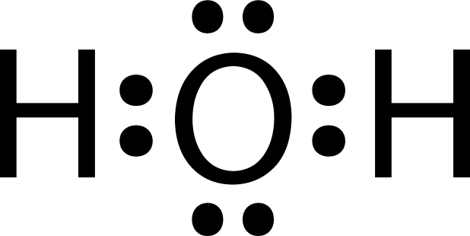
VSEPR Theory
Valence-shell electron pair repulsion
Outermost electrons
bonds + lone pairs
repel each other

Slide 15
VSEPR Theory
In any molecule or ion, there are regions of high electron density:
Bonds (shared electron pairs)
Lone pairs (unshared electrons)
Due to electron-electron repulsion, these regions are arranged as far apart as possible
Such arrangement results in the minimum energy for the system
Ch 10.1
Page 415

Slide 16
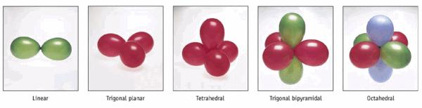
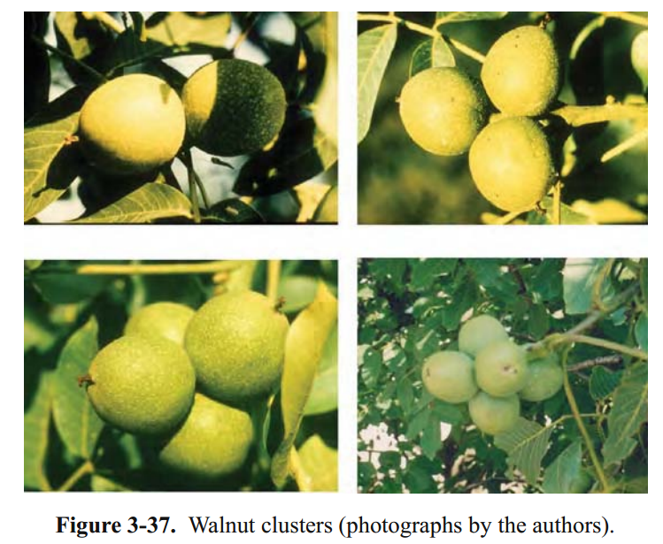
VSEPR Theory

Slide 17
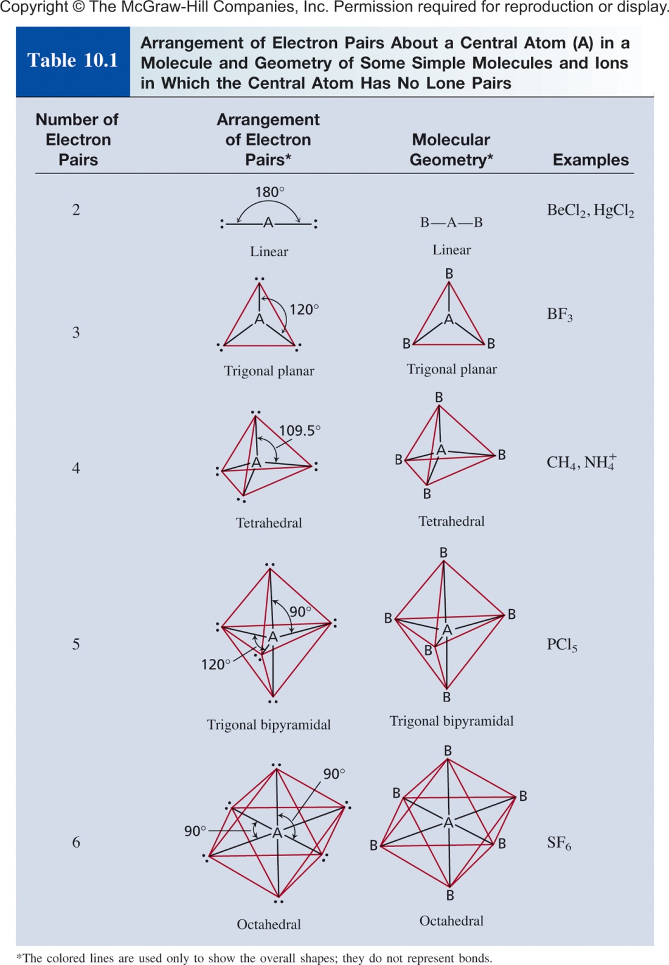
Ch 10.1
Page 416

Slide 18
Predicting Molecular Geometry
Draw Lewis structure for molecule.
Count number of lone pairs on the central atom and number of atoms bonded to the central atom.
Use VSEPR to predict the geometry of the molecule.

Slide 19


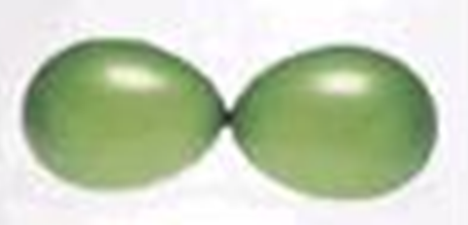
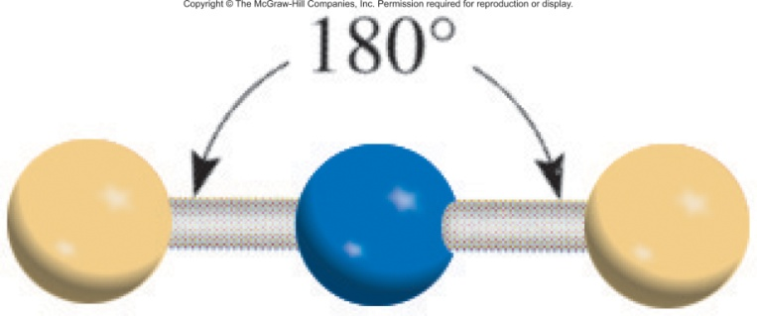
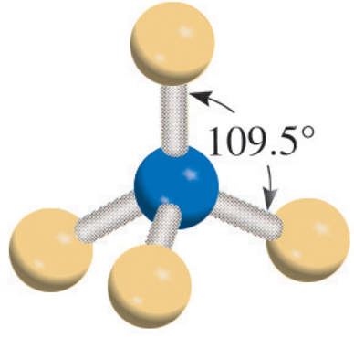
Examples
Beryllium Chloride (BeCl₂)
Methane (CH₄)
2 e⁻ balloons
4 e⁻ balloons
Ch 10.1
Page 417

Slide 20

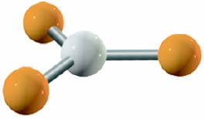
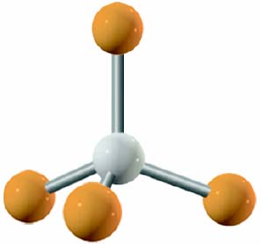
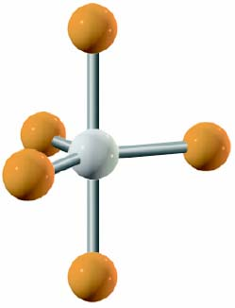
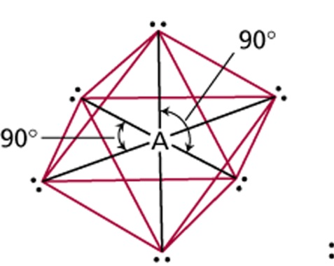
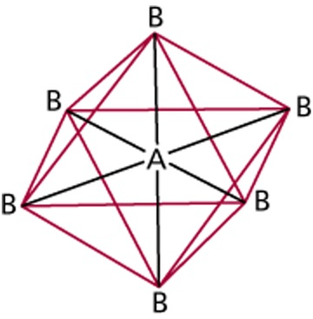
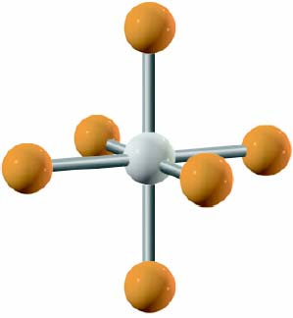
VSEPR Theory
# of atoms
bonded to central atom
Arrangement of electron pairs
Molecular
Geometry
Class
AB₂
2
linear
linear
trigonal planar
trigonal planar
AB₃
3
AB₄
4
tetrahedral
tetrahedral
trigonal
bipyramidal
trigonal
bipyramidal
AB₅
5
AB₆
6
octahedral
octahedral

Slide 21
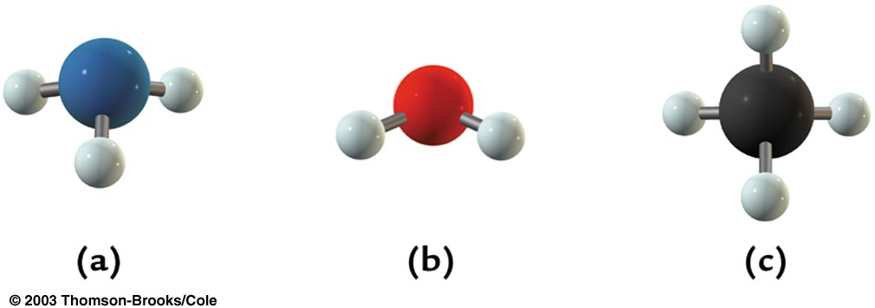
Electronic vs Molecular Geometry
Electronic geometry
Distribution of regions of high electron density around the central atom
Molecular geometry
Arrangement of atoms around the central atom
Electronic
Geometry
NH₃
H₂O
CH₄
Tetrahedral
Molecular Geometry =
Triagonal Pyrimidal
bent
tetrahedral

Slide 22
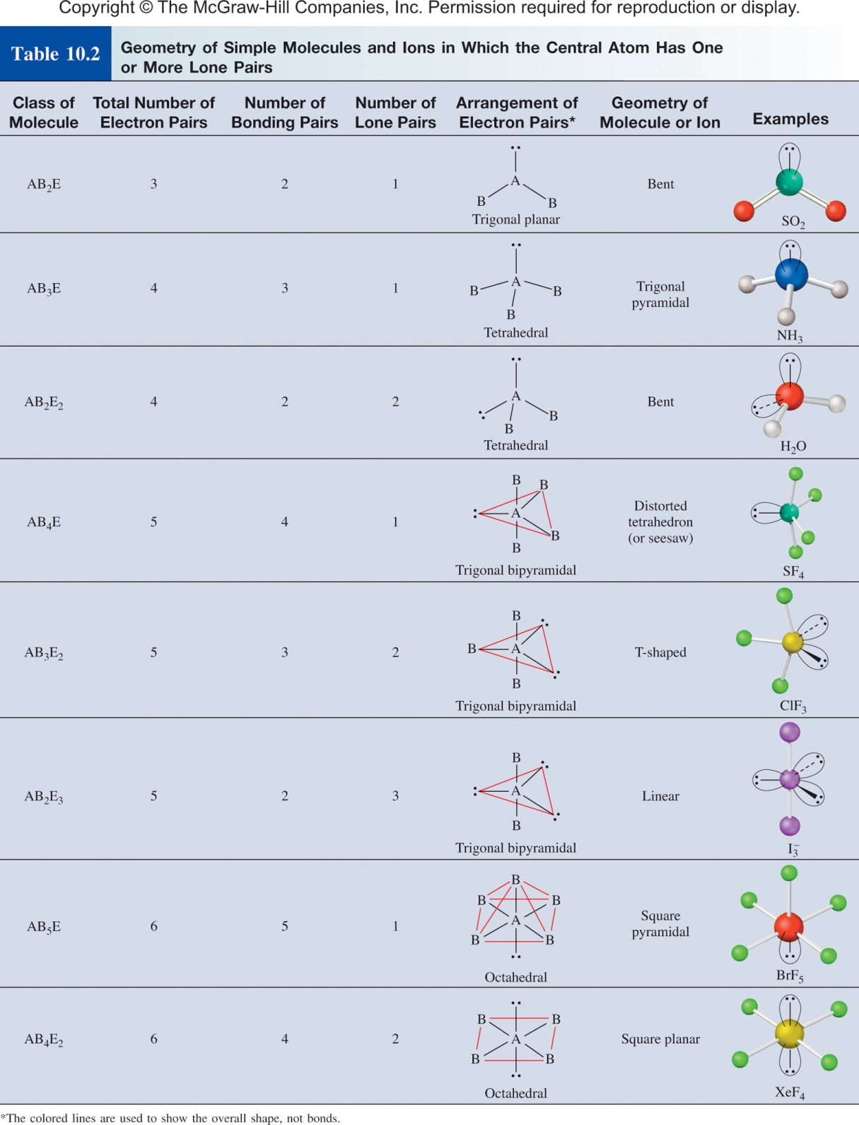
B = atom
E = lone pair
Ch 10.1
Page 422

Slide 23
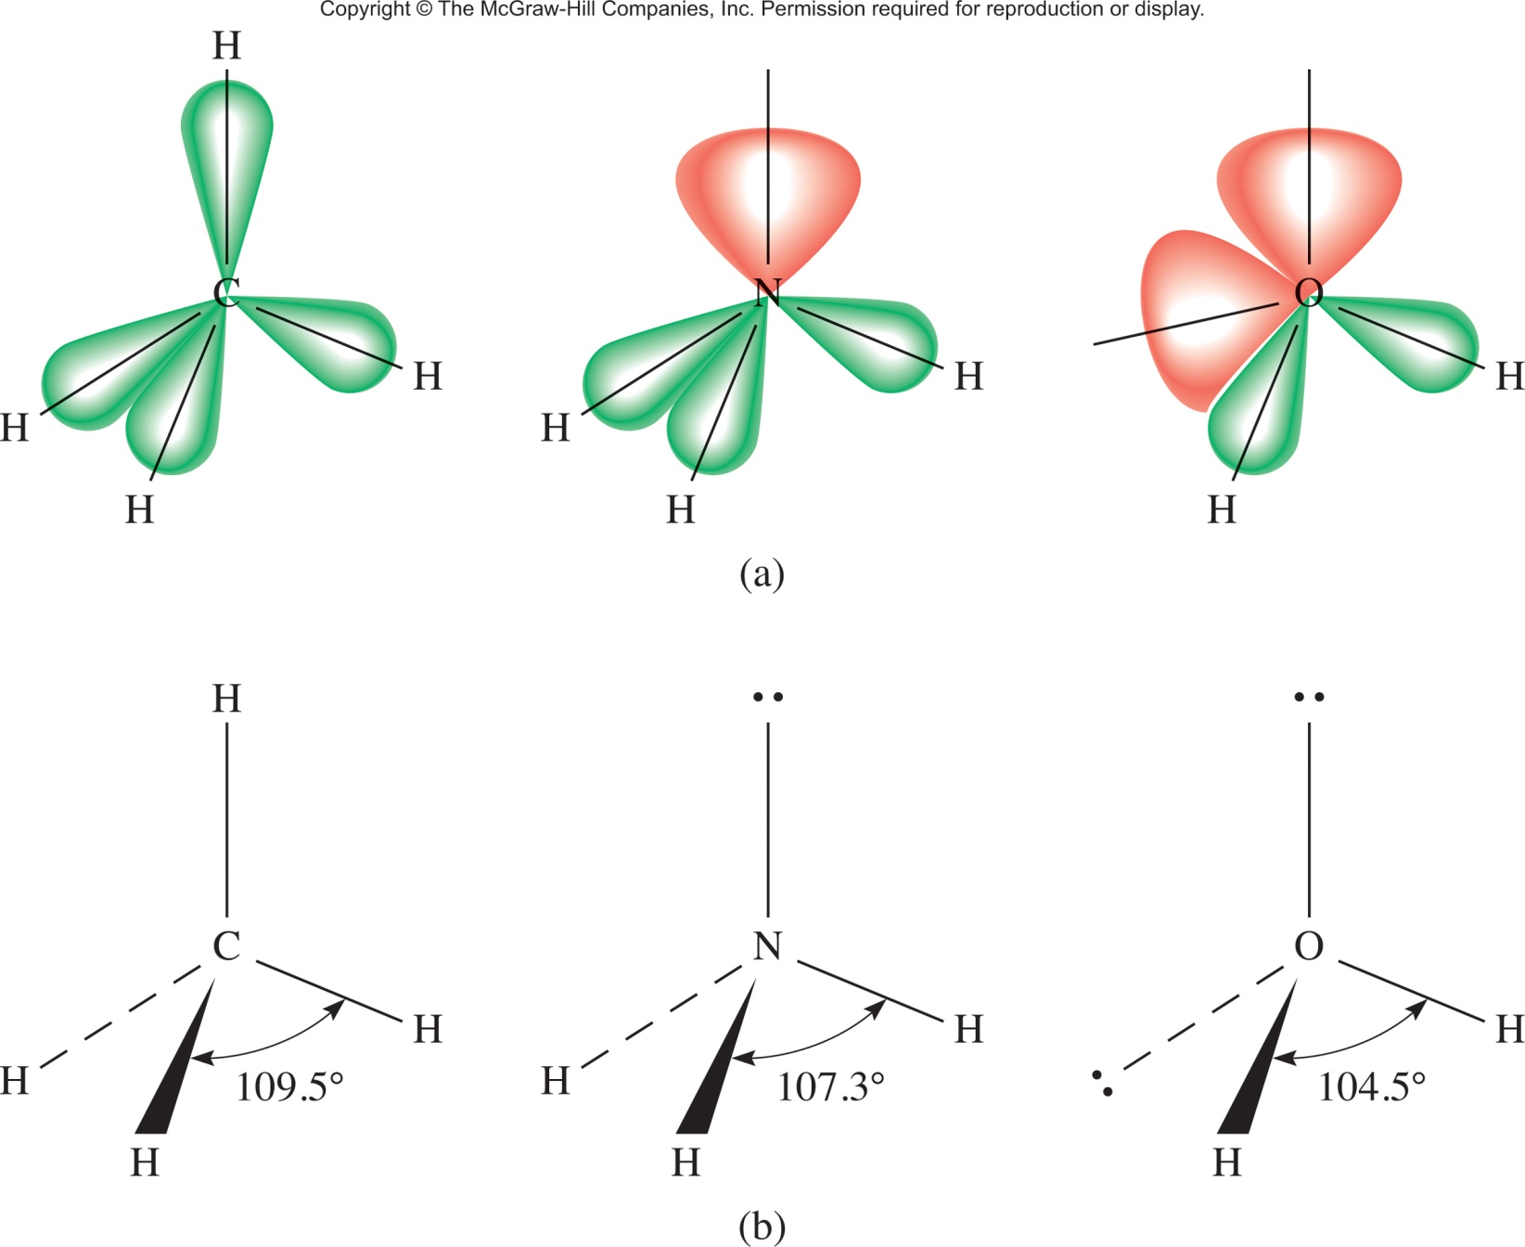
Predicting bond angles
A lone pair takes up more space than a bond
Ch 10.1
Page 420

Slide 24
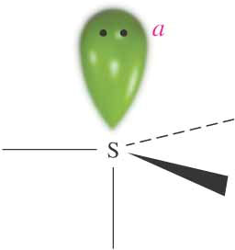
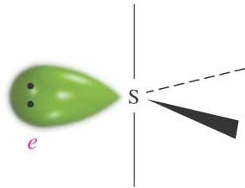
Geometry of SF₄
A lone pair takes up more space than a bond
SF₄ Electronic geometry: 5 e⁻ balloons = triaganol bipyrimidal
Which of these is the correct molecular geometry?
F
F
F
F
or
F
F
F
F
3 bonds at 90°
1 bond at 180°
2 bonds at 90°
2 bonds at 120°

Slide 25
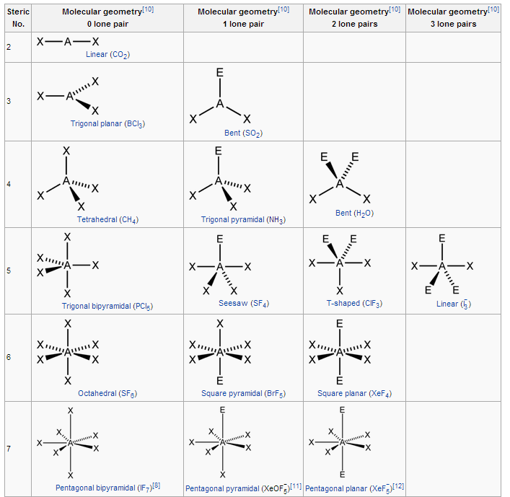
VSEPR Theory
X = atom
E = lone pair

Slide 26
Five Basic Geometries
Linear
Trigonal
Tetrahedral
Trigonal bipyramidal
Octahedral
Reality
vs
Plato
Tetrahedron
Hexahedron
Octahedron
Dodecahedron
Icosahedron

Slide 27
Chapter 10
Why molecular geometries matter!

Slide 28


Dipole Moment
Dipole moment (μ)
The product of the charge Q and the distance r between the charges Q+ and Q–
μ = Q × r
Measured in debyes (D)
1 D = 3.336×10^{–30} C m
Polar Covalent Bonds
Bonds between elements with different electronegativity have an asymmetric electron density distribution
Ch 10.2
Page 425

Slide 29
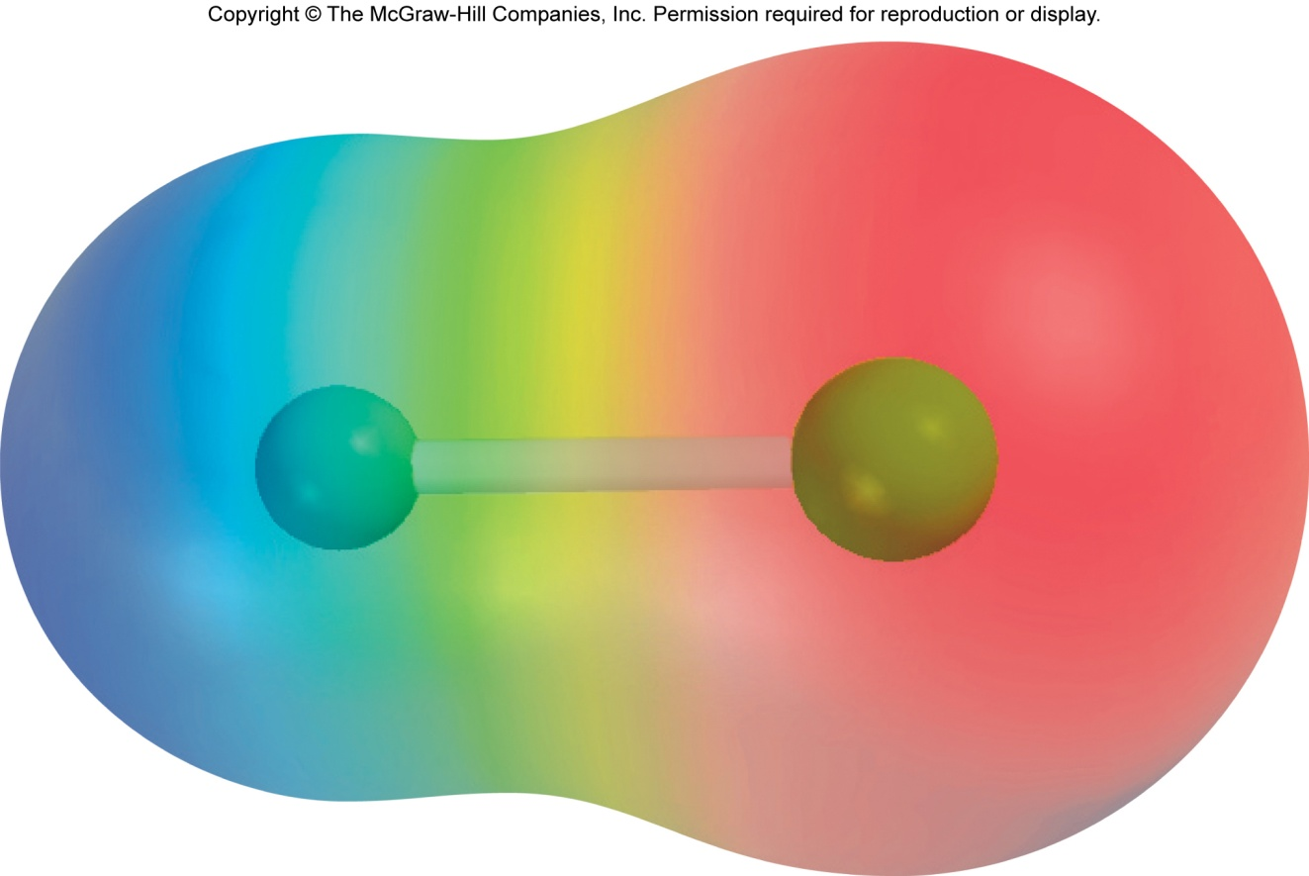
Dipole Moments and Polar Molecules
electron rich
region
electron poor
region
H
F
δ+
δ−
μ = Q x r
Q is the charge
r is the distance between charges
1 D = 3.36 x 10⁻³⁰ C m

Slide 30


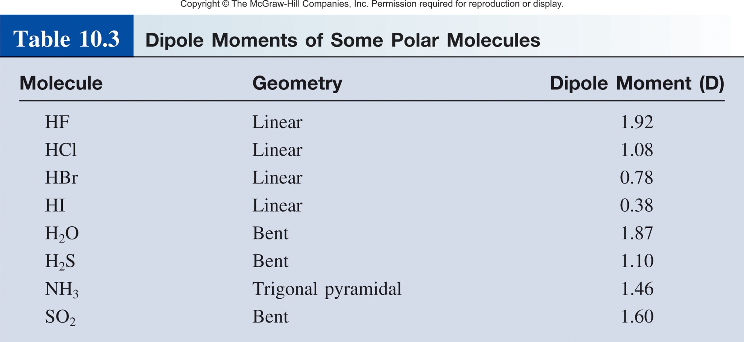
Examples of Dipole Moments
μ = Q × r
Measured in debyes (D)
1 D = 3.336×10^{–30} C m
r

Slide 31
Polar and Nonpolar Molecules
Nonpolar Molecule
Dipole moments for all bonds cancel out
Polar Molecule
Dipole moments for all bonds don’t cancel out – the molecule has the resulting net dipole moment
Important to Note
Even if a molecule contains polar bonds, it might be nonpolar, i.e. its total dipole moment = 0

Slide 32
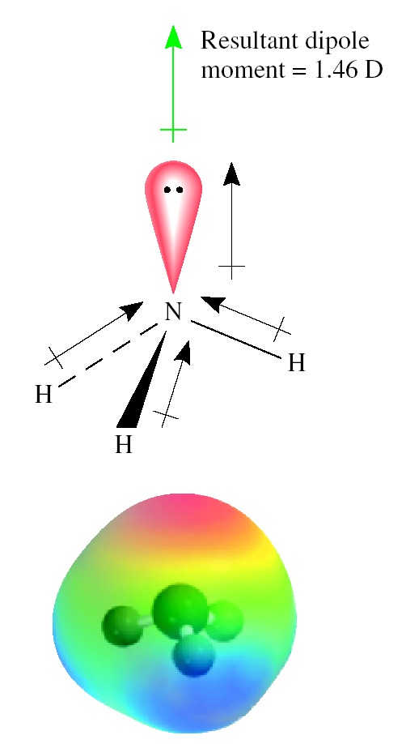
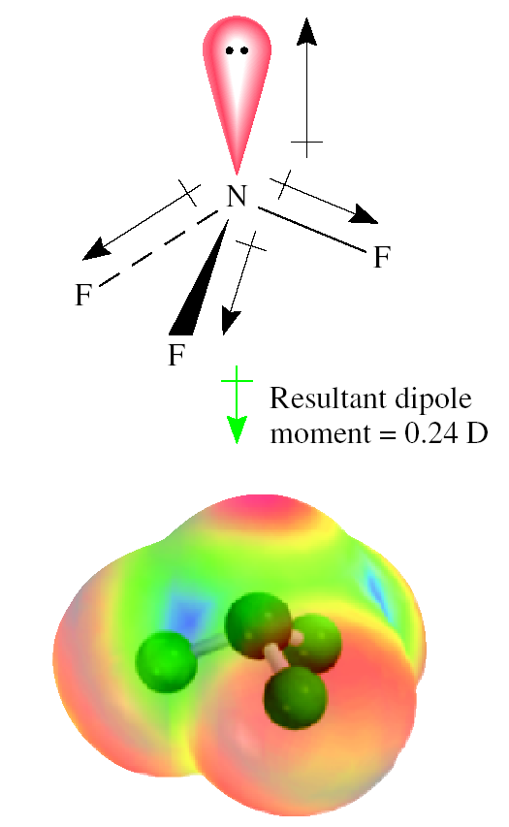
Dipole Moments of NH₃ and NF₃
Ch 10.2
Page 427

Slide 33
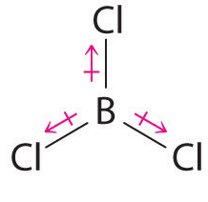
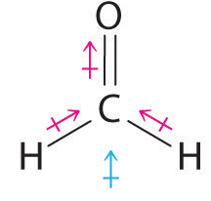
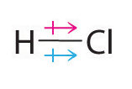
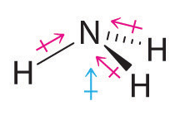
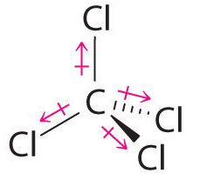
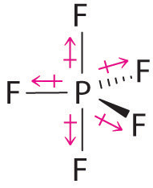
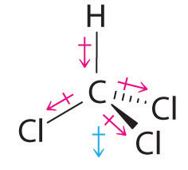
Polar and Nonpolar Molecules
Bond Dipole
Molecular Dipole

Slide 34
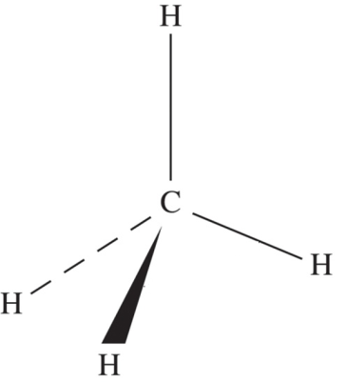
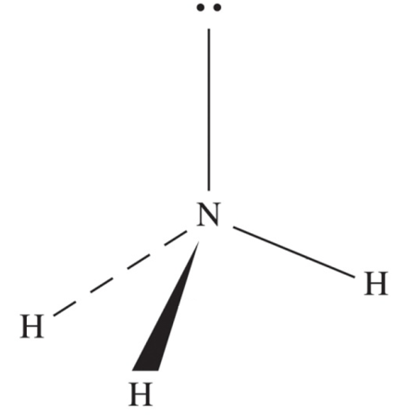
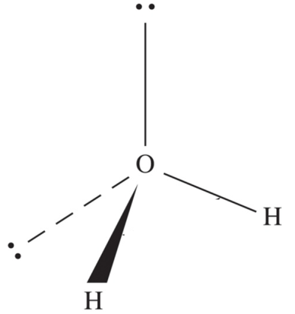
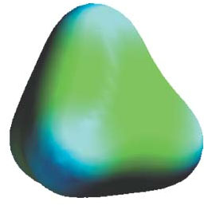
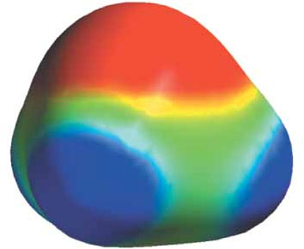
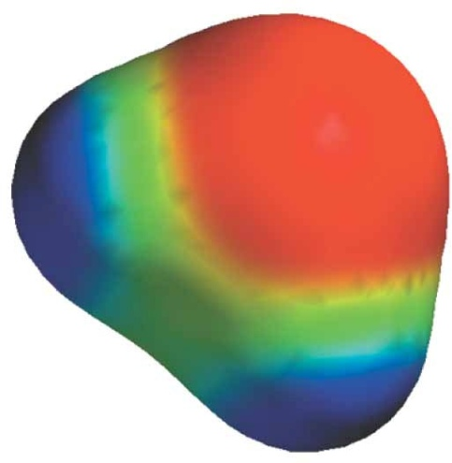
Polar and Nonpolar Molecules
CH₄
NH₃
H₂O
Red – more electron density (more negative)
Blue – less electron density (more positive)

Slide 35

Quick Quiz

Slide 36


Why should we care?
Solubility
Miscibility
Boiling/melting points
pK_{a}
Optical Transitions
Crystal Structure/Property
Thermal Electrical Conductivity
Intermolecular Forces
LCD screens

Slide 37
Chapter 10

Slide 38
VSEPR Theory
X = atom
E = lone pair

Slide 39
Dipole Moments and Polar Molecules
electron rich
region
electron poor
region
H
F
δ+
δ−
μ = Q x r
Q is the charge
r is the distance between charges
1 D = 3.36 x 10⁻³⁰ C m

Slide 40
Polar and Nonpolar Molecules
Bond Dipole
Molecular Dipole

Slide 41
Chapter 10

Slide 42
Beyond Lewis Dots
Chemical bonds- Attractive forces that hold atoms together in compounds are called chemical bonds.
Covalent bonds – resulting from sharing of one or more electron pairs between two atoms
Not an accurate depiction of a chemical bond!
Electrons don’t just occupy one atom.
For a better description we turn to molecular orbital theory.
Ch 10.6
Page 445

Slide 43
Molecular Orbital Theory
The main postulates:
Electrons have wave like properties that define their orbital.
Interaction of the atomic orbitals (AOs) leads to the formation of molecular orbitals (MOs) associated with the entire molecule
The total number of MOs formed equals to the total number of AOs involved in their formation
The AOs combine in-phase (constructively) and out-of-phase (destructively), which leads to different energies of the resultant MOs

Slide 44




Molecular Orbital Theory
Electrons around an atom can be described as waves.
Waves can interact-
constructively
destructively
bonding interaction
anti-bonding interaction
Hydrogen-
1s orbital
1s wavefunction
Ch 10.6
Page 446

Slide 45

MO Energy Level Diagram
In-phase – bonding MO – σ_{1s}
Out-of-phase – antibonding MO – σ∗_{1s}
Ch 10.6
Page 447

Slide 46

Moving on to p-Orbitals
Hydrogen-
1s orbital
1s wavefunction
Larger Atoms (Li,B,C,N,O)-
p orbital
p wavefunction

Slide 47






Interaction of p-Orbitals
Ch 10.6
Page 448

Slide 48




Diatomic MO Diagram

Slide 49

Diatomic MO Diagram
MO theory predicts why oxygen is magnetic.
Ch 10.7
Page 453

Slide 50



Magnetic Oxygen
2 unpaired e⁻magnetic
0 unpaired e⁻not magnetic

Slide 51

MOs of Ferrocene FeC₁₀H₁₀

Slide 52



Why do we care about MOs?
Magnetic Properties
Oxidation/Reduction Potentials
Catalytic Activity
Stereoselectivity
Enzyme Binding

Slide 53
Chapter 10

